Slide 1

Objective
To build a model to predict the electrical energy output of a Combined Cycle Power Plant
Modelling Approach
Building a Model
Model evaluation
Model interpretation
Data
9568 hourly average ambient environmental readings
Temperature (T) | Ambient Pressure (AP) | Relative Humidity (RH) | Exhaust Vacuum (V) | Net hourly electrical energy output (PE)
1.81°C to 37.11°C | 992.89-1033.30 milibar | range 25.56% to 100.16% | 25.36-81.56 cm Hg | 420.26-495.76 MW (Target)

Slide 2
Modelling Details
Used Google AutoML
Regression Model
Training, Test and Validation Data was autoselected at 80-10-10%
4 Training models created
Default metrics RMSE used except model 4 where the metrics was changed to MAE

Slide 3
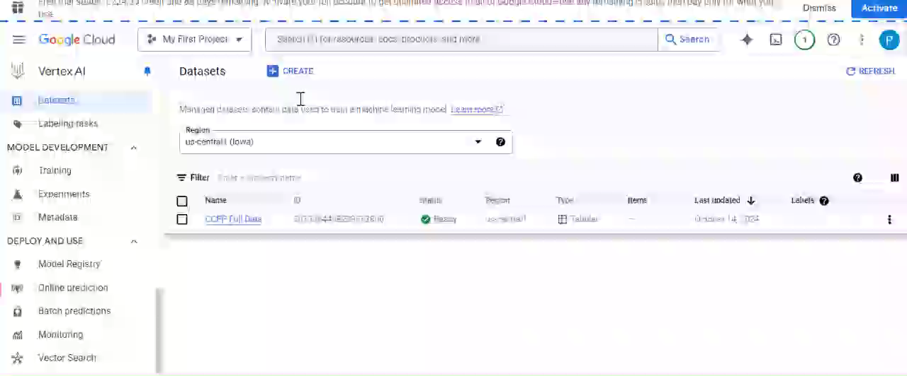
Creating a Dataset

Slide 4
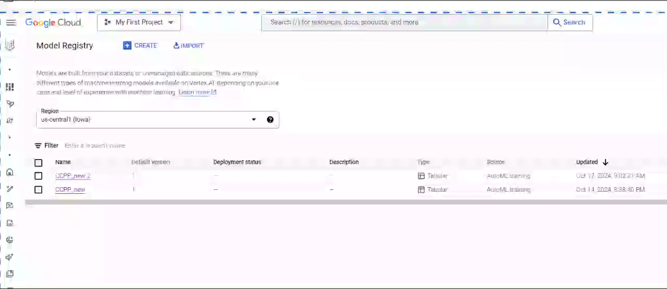
Model 1 and 2

Slide 5
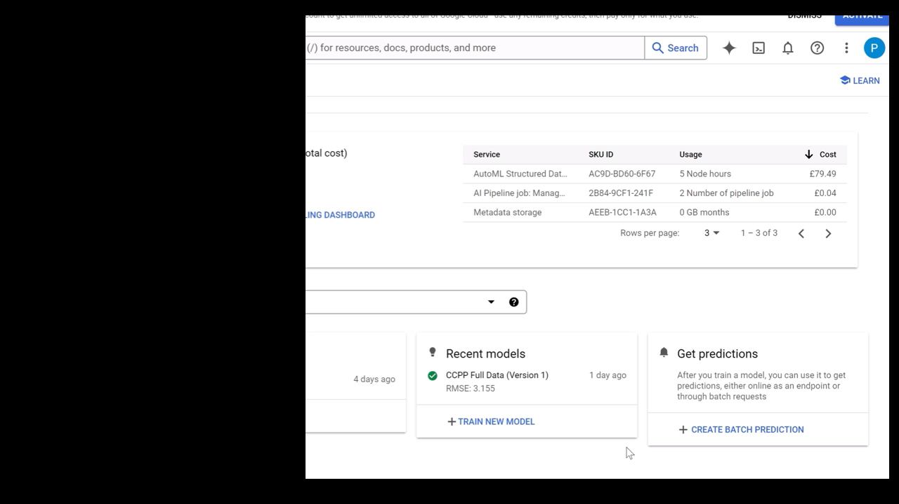
Creating a new Training Model 3

Slide 6
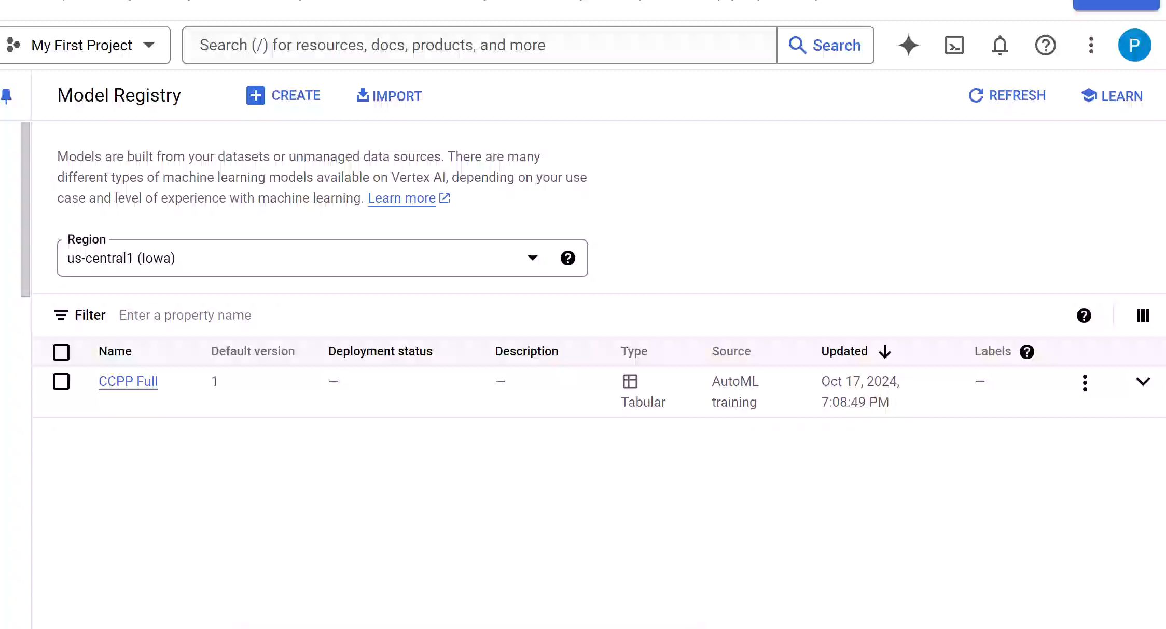
Model 4

Slide 7
Training Models - Results
Model # | Features | Metric | MAE | MAPE | RMSE | RMSLE | r^2
Training Model 1 | AT, V AP, RH | RMSE (default) | 2.485 | 0.549 | 3.224 | 0.007 | 0.963
Training Model 2 | AT, V, AP | RMSE (default) | 2.594 | 0.572 | 3.372 | 0.007 | 0.959
Training Model 3 | AT, V | RMSE (default) | 3.246 | 0.716 | 4.079 | 0.009 | 0.941
Training Model 4 | AT, V AP, RH | MAE | 2.41 | 0.532 | 3.155 | 0.007 | 0.965

